Slide 1
PRESENTATION DELIVERY SKILLS
SCRIPT DEVELOPMENT
ORGANIZATION-ORDER OF INFORMATION

Slide 2
STORYBOARD & SCRIPT DEVELOPMENT
Develop a storyboard first.
A graphically organized illustrations or images displayed in a sequence for the purpose of pre-visualizing a motion picture, animation, motion graphic or interactive media sequence.

Slide 3
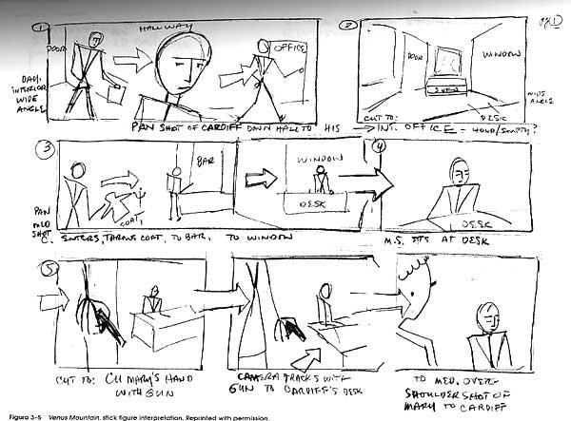
An example of Storyboard

Slide 4
Organization of the Contents
Your presentation will have three components:
1. The Introduction
2. Main Body
3. The Conclusion
Use a storyboard to create all the three components.

Slide 5
PRESENTATION DELIEVRY SKILLS

Slide 6
Points to Ponder
Since a presentation is planned, rehearsed, and practiced, one has to determine the delivery of the content in addition to the OUTLINE.
How you deliver the presentation includes
Deciding on the communication strategies you will employ to convey the ideas
Preparing a sequence

Slide 7
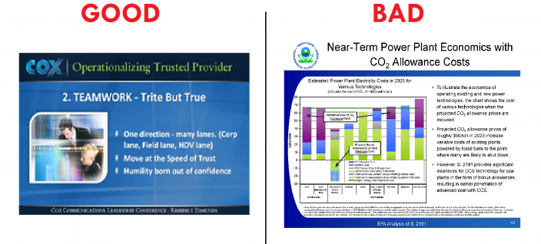
Good slide vs Bad slide

Slide 8
INTRODUCTION
This is the most important part of the presentation.
You have to accomplish 4 objectives here:
Sharing the title.
Capturing audience attention
Generating interest
Giving a clear idea about the topic and purpose of the presentation- an argument.

Slide 9
Task: What attention graber has the writer used?
Thomas Jefferson once said "I'm a great believer in luck, and I find the harder I work, the more I have of it." What, though, is luck? Webster's dictionary suggests that luck is the "events or circumstances that operate for or against an individual."
In truth, luck has nothing to do with something operating for or against you. Luck is not a matter of chance. It is a matter of being open to new experiences, perseverance, hard work, and positive thinking.

Slide 10
Task: What attention graber has the writer used?
Dear students, where are you going to be in five years? What will you be doing from 9 till 6 every day? In what sphere will you work? In other words, what are your career objectives? Some of you must be thinking that the third year of studies is yet too early to ask such questions. Let me assure you that it is high time to decide upon this issue.
In fact, as my 7 year-long experience as HR-manager shows, there are only two alternatives. Either you think about your career beforehand - now! - or you graduate in two years with an empty track record, and cling to the very first job available with the highest salary. "Not bad at all", some of you might think. Still, believe me that you will soon get bored, for money is not the sense of life.

Slide 11
INTRODUCTION
Greet the audience.
Introduce your topic and the purpose of the presentation.
Establish credibility by introducing yourself, you designation, your organization, etc.
Capture the listeners’ attention, develop interest, stimulate curiosity.
Some techniques to grab interest are
  a thought provoking question, invite participation
  a startling fact, statistic
  a joke, story, quotation.
  an interesting observation

Slide 12
INTRODUCTION
Now reveal the thesis statement and an outline indicating the contents of your presentation.
Set rules for Q & A
Remember, here is where you have to give your best!

Slide 13
MAIN BODY
Give information, but make sure you maintain the interest you aroused in the introduction.
Develop connection between the ideas.
Follow some information organizational pattern.

Slide 14
MAIN BODY- Info. organizational patterns
The order of information:
Topical
Chronological
Problem/Solution
Cause/Effect

Slide 15
MAIN BODY
Make a point-transition,…make a point-transition,…make a point-transition, etc…
Supporting evidence (it develops your points)
Examples
Feedback & questions from audience (if necessary)
Attention to, and focus on, audience…
are they listening?

Slide 16
MAIN BODY
Make your talk interesting and Explain the points using:
  analogies
  metaphors
  similes
  Logos, ethos and pathos
  personal anecdotes, observations
  hypothetical scenarios
Use words of transitions or verbal sign posts to indicate shift from one point to the other.

Slide 17
TASK: Which Support Material is used here?
When larger amounts of caffeine (over 600 mg per day) are ingested over long periods of time, they can cause sleep problems, depression and digestion issues.
According to a Medline article on the National Institutes of Health website, having caffeine in your diet is not of any benefit to your health, but by the same token moderate consumption is not considered harmful.
They say that having up to 3 eight ounce cups of coffee a day - or 250 mg of caffeine - is considered (quote) "average or moderate". 10 cups of coffee a day is considered excessive. Also, remember that the amount of caffeine per cup can vary greatly depending on the type of beans that are used and the strength of the brew.

Slide 18
Task: Which Support Material is used here?
Scientists and doctors in the Western world suggest that energy medicine is little more than a scam. One article went so far as to report that most called it "outrageous quackery." In fact, many warn that energy medicine is quite dangerous to those with serious medical conditions, as many choose these practices over more traditional medical procedures.
A 1993 New England Journal of Medicine study, though, went against the medical establishment in suggesting that thousands use energy medicine successfully for chronic pain their doctors are simply unable to treat.

Slide 19
Task: Which Support Material is used here?
The facts are that secondhand smoke is responsible for many of the same diseases as if you were sucking on the cigarette yourself. These diseases include cardiovascular diseases, lung cancer, and respiratory diseases.
For example, the International Agency on Research on Cancer found that “involuntary smoking is carcinogenic to humans." Various studies in the United States, Australia, and the United Kingdom point to a significant increase in risk of lung cancer among those exposed to passive smoke.

Slide 20
CONCLUSION
Note that the listeners will remember conclusion more than any other part of the talk.
Hint the closing using transitions like, to sum up, in the end.
Restate thesis and summarize main points
  “Tell them What You Told them.”

Slide 21
CONCLUSION
Something to remember, or call-to-action, give recommendations here
Note: Remember to end gracefully and focus on what you want the listeners to remember or do
Open the floor for Q & A session

Slide 22
Sample Conclusions
Proponents of the idea that luck is a matter of chance will tell you that some people are just lucky. Some will even tell you that luck happens in phases, and that a bit of luck is sure to come your way eventually. The simple truth of the matter, though, is that luck is not a matter of chance.
The great Lucille Ball once said, "Luck? I don't know anything about luck. I've never banked on it, and I'm afraid of people who do. Luck to me is something else: Hard work -- and realizing what is opportunity and what isn't."
You make your own luck in this life, and the great thing about it is that anyone can do it. Lucky you!

Slide 23
Sample Conclusions
Secondhand smoke in the home is one problem. But to go to a public restaurant, or concert, or any event and to experience secondhand smoke is not only rude, it's impacting the health of our population, increasing healthcare costs and should be banned by federal mandate in the next session.
While you have the option to smoke, I don't have the option of not breathing.
Nor do our children.

Slide 24
Q & A session
Make sure that you understand the question thoroughly. Do not be impolite or rude if you get an offensive remark or question. You can use the following phrases:
I’m glad you asked that question…
That’s a good question/remark…..
I agree with you but there is another way of looking at things…….

Slide 25
MARKED TASK.
Work in groups and prepare a presentation on any topic from computer science domain.
There will be group presentations in the second week (8th in course outline) after mid 1.

Slide 26
Thank You

